Slide 1
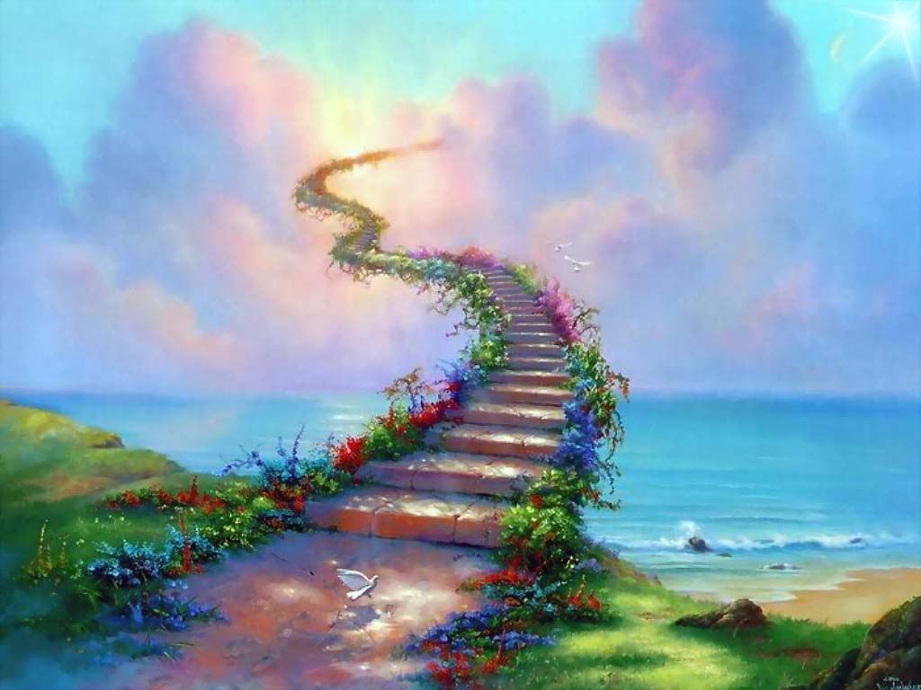
Writing: Quick Write A moment in Time Task: Using the Image - Describe in detail what is happening at this very moment in time, imagine we have frozen time.
What is happening? | What are you feeling? | What are you seeing? | What are you hearing? | What is going through your head?
Please write 2 or more ideas from each box

